Slide 1
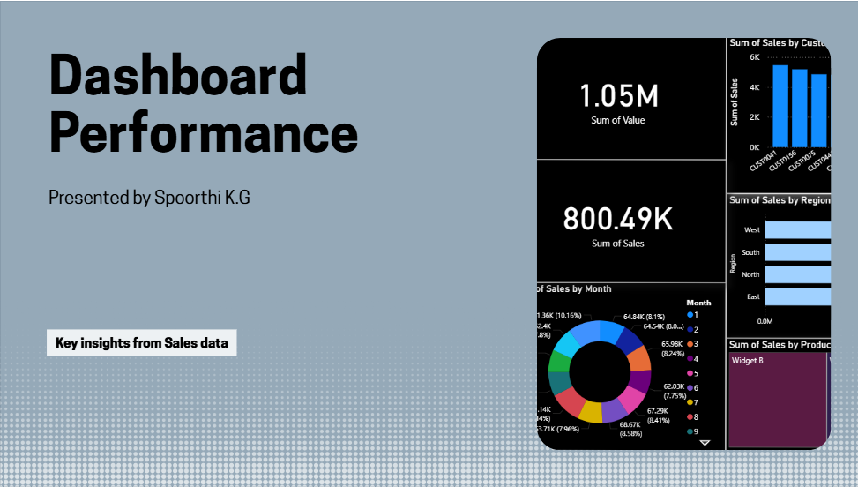

Slide 2
Key Highlights
Total Sales Value: 1.05M
Total Sales Volume: 800.49K
Strong performance across multiple customers and products.
Seasonal fluctuations observed in monthly sales.

Slide 3
Sales by Customer
Insight:
Sales are evenly distributed across top customers
Each customer contributes between 4K–6K in sales Visual: Bar chart of sales by CustomerID

Slide 4
Sales by Year
Insight:
2021 saw a significant dip in sales
Recovery observed in 2022 and 2023
2024 shows stable performance Visual: Line chart of sales by year

Slide 5
Sales by Region
Insight:
West region leads in sales
South and North regions show similar performance
East region lags behind Visual: Horizontal bar chart of sales by region

Slide 6
Sales by Month
Insight:
Sales fluctuate significantly month-to-month
Peaks observed in mid-year months
Opportunities to stabilize sales in low-performing months Visual: Line chart of sales by month

Slide 7
Sales by Product
Insight:
Widget B and Widget C are top-performing products
Accessories and Gadgets contribute moderately
Widget A shows potential for growth Visual: Treemap of sales by product

Slide 8
Sales Distribution by Month
Insight:
Sales are spread across months with notable peaks
Highest sales in June and July
Lowest sales in February and October Visual: Donut chart of monthly sales distribution

Slide 9
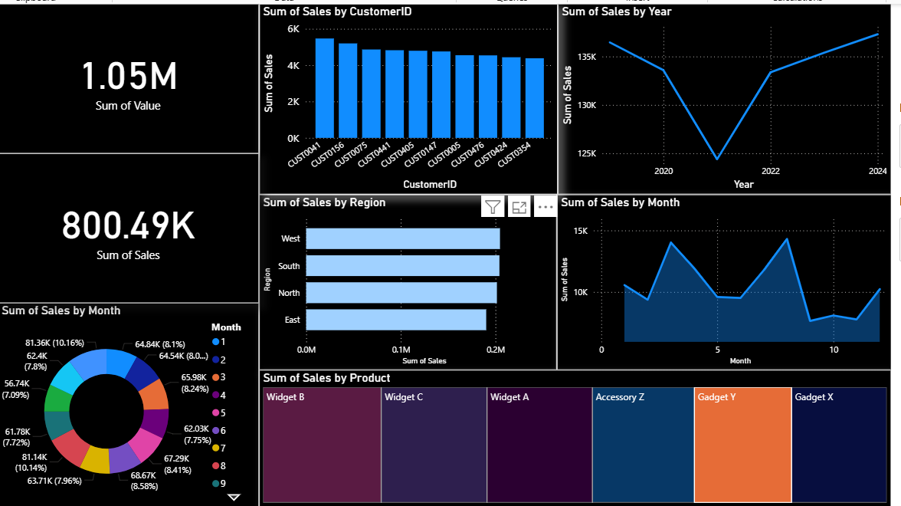
Dashboard Screenshot

Slide 10
Recommendations
Focus on boosting sales in East region
Strengthen marketing for Widget A to increase share
Develop strategies to reduce seasonal dips
Leverage strong customer base for upselling opportunities

Slide 11
Conclusion
Overall sales performance is strong with steady growth
Regional and product-level opportunities exist
Strategic focus can drive consistent year-round sales

